Slide 1
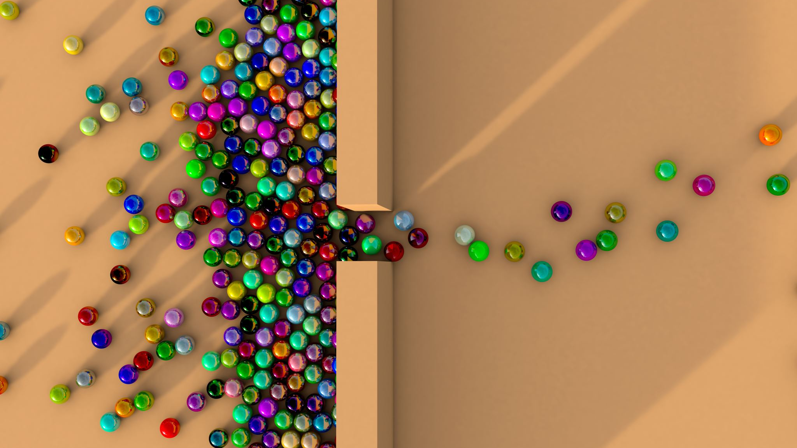
Immobilized beads in PBR
Laxman Manjhi 2019BB10034
Ratnesh Kumar Sharma 2019BB10047

Slide 2
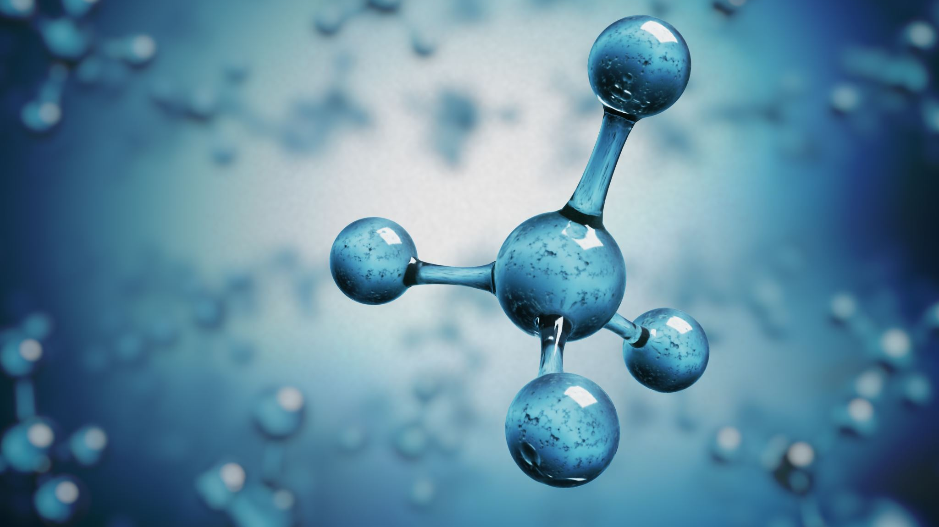
Background
The experiment involves immobilizing the enzyme invertase in calcium alginate beads for use in a packed bed reactor (PBR).
Gel entrapment is used to immobilize the biocatalyst within a polymeric network without modifying its conformation.
The beads are created by forcing the mixture of biocatalyst and polymeric solution through a fine orifice into a salt solution that causes insolubilization through ion exchange.
The size and shape of the beads can be controlled by varying the orifice diameter and the distance of the nozzle from the liquid surface.
Immobilized enzymes can provide high yield of immobilization and are useful in industrial applications.
In this experiment, sucrose is used as the substrate, and alkaline DNS and 50mM sodium acetate buffer are used to perform kinetic characterization of the calcium alginate beads.
The enzyme activity is calculated using standard curve based on absorbance readings taken at 540nm.

Slide 3
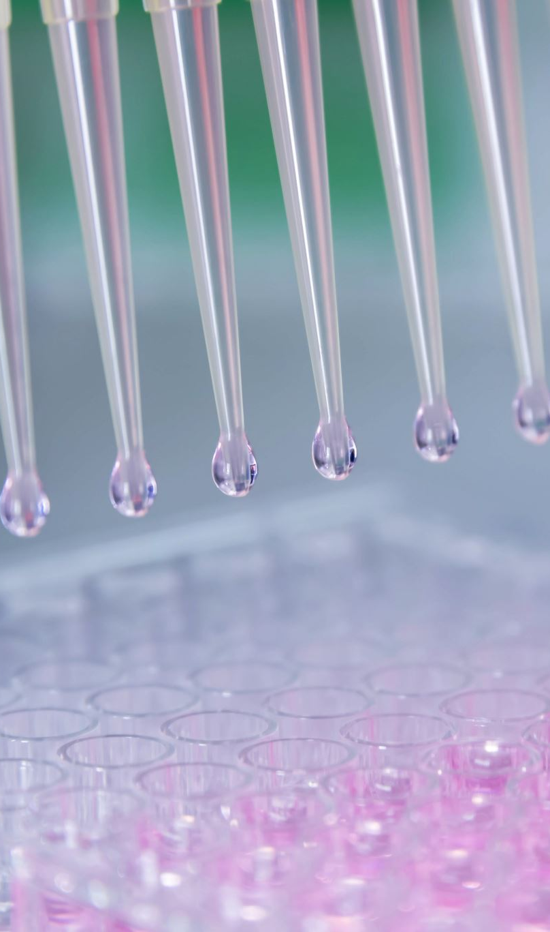
Procedure
The glass vessel was filled to ⅓ height with glass wool.
The prepared calcium alginate beads (40ml) were added to the vessel.
The vessel was then filled with glass wool.
The flow rate was adjusted to 2mL/min.
The input and output lines were connected, and the substrate was passed through the packed bed.
50 µL samples were collected every 0, 10, 20, 30, 40, 50, and 60 minutes.
The kinetic characterization of the calcium alginate beads was performed as follows:
200µL of alkaline DNS was added to the 50µL sample obtained from the reactor.
The mixture was incubated at 90oC for 5 minutes.
200µL of 50mM acetate buffer at pH 4.8 was added to the mixture.
A blank sample without enzyme was prepared by adding sucrose, DNS, and acetate.
Absorbance readings were taken at 540nm, and enzyme activity was calculated using a standard curve.

Slide 4
Observation
Time | Abs
0 min | 0.092
10 min | 0.128
20 min | 0.283
30 min | 0.253
Dilution | 100X

Slide 5
Enzyme activity calculation
Time (min) | Abs | ε (mM^-1 cm^-1 | l (cm) | Df | C2 (mM) | ΔC (mM) | Δt (min) | Activity
0 | 0.092 | 14.2 | 1 | 100 | 0.648
10 | 0.128 | 14.2 | 1 | 100 | 0.901 | -0.25 | 10 | -0.03
20 | 0.283 | 14.2 | 1 | 100 | 1.993 | -1.09 | 10 | -0.11
30 | 0.253 | 14.2 | 1 | 100 | 1.782 | 0.21 | 10 | 0.02

Slide 6

Thank you

